Slide 1
Capstone Project
www.collaberadigital.com

Slide 2
Personal BACKGROUND
(Name, Past Experience, Qualification, Career Summary)
Name : Jeorge L. Emprese
Past Experience : Software Engineer at AXA Philippines (Pointwest Squad Inc.)
Qualification : ASP. Net MVC, ASP.NET Core MVC, C#,MS SQL
Career Summary :
Develop systems and software that allow users to perform specific tasks on computer and other devices. Proficient in C#, ASP.NET MVC, HTML, CSS, Javascript etc. Ability to translate business requirements into technical solutions. I have more than 3 years developing and maintaining desktop applications using VB.net, more than 2 years developing and maintaining web applications using ASP.NET MVC and a year on web application using PHP CodeIgniter 3 Framework.

Slide 3
Key Takeaways/Learnings from the Program (HTD)
Java Fundamentals
Since I came from the .net background it is a great experience to have a refresher course of the concepts and principles of Java.
Extend Controller Command
If you want to add a function or method in an existing controller command, you will need to extend it on the controller command that you created.
In order to execute the existing function in the extended controller command, you need to override the performExecute() method and if you are passing parameters you also need to override the setRequestProperties().
Customize CalMethods Logic
Customization of the existing calMethods not limited to Tax calculation that are based on the business needs.
This will be helpful in times that you have a different calculation of tax that depends on the area of the customer.

Slide 4
Key Takeaways/Learnings from the Program (HTD)
General Troubleshooting
Adding breakpoint to a certain line to see if it will correctly pass the value that was expected by the developer.
The first thing to look at is the logs to see what causes the error and then track and trace to where specific component the error occurred.
WCS Utilities
Even though we won't be using it much as developers, these utilities are a huge help in maintaining and modifying the contents and other features of the E-commerce website.
Introduction to E-Commerce
Since I don’t have any experience in e-commerce, this training helped me to be familiar with the concepts and principles in e-commerce.

Slide 5
Problem Statement of the Capstone Project
Capstone Project Part 1
Step
Step
Step
01
Add data into CATENTRY table field 3 (Product Ranking) & field 4 (Rating Company)
02
Add these two fields to Solr Index then display the information on PDP.
03
Add one attribute “isGiftWrappable” to a specific product using dataload.
Table involved: CATENTRY
Solr Index extension & Product ranking customization
Tables involved: ATTR, ATTRVAL, ATTRVALDESC, ATTRDESC,CATENTRYATTR
Step
Step
Step
04
05
Allow customer to avail gift wrapping service by ticking the checkbox
and they can add a message on an input
06
Display the gift wrap service details together with other product attributes if the customer availed it.
Select the product with extended attribute to be directed to its PDP and add this product to your basket
Gift wrapping service data to be saved in
ORDITEMEXTATTR
Pages involved: Order Confirmation, Order
Check Out page.

Slide 6
Problem Statement of the Capstone Project
Capstone Project Part 2
Step
Step
Step
Create a new JSP for this user custom information
01
Create a new custom table
in WCS DB
02
Create a JPA to save, update & read the data from the newly created custom table.
03
Option 1: Add a new link in Settings sidebar under “Quick Checkout Profile”
Option 2: Add a new form inside Personal Information page by calling the new JSP.
Table fields: UniqueId, UserId,Favorite_Food,Favorite_Color,
OptCounter
Step
Step
04
05
Save this form data in the custom table created in WCS DB using the JPA and controller command you created.
Create a new controller command to save this custom information.

Slide 7
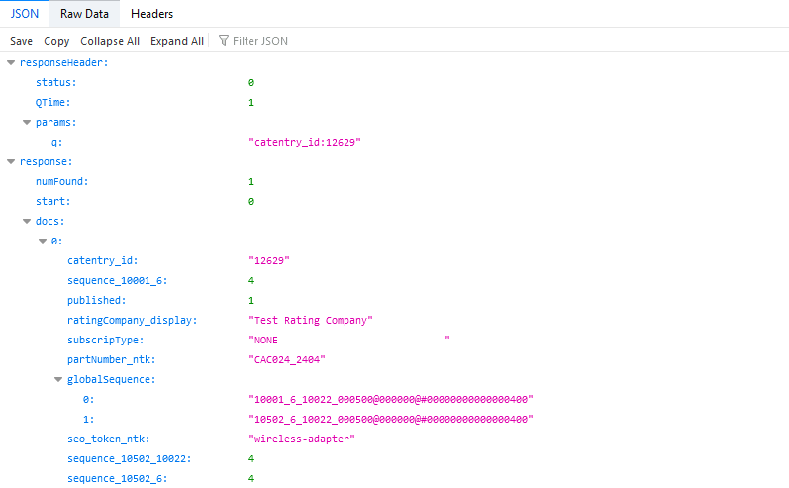
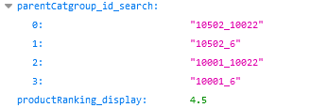
Important areas of the Project with screenshots
Solr Indexing

Slide 8
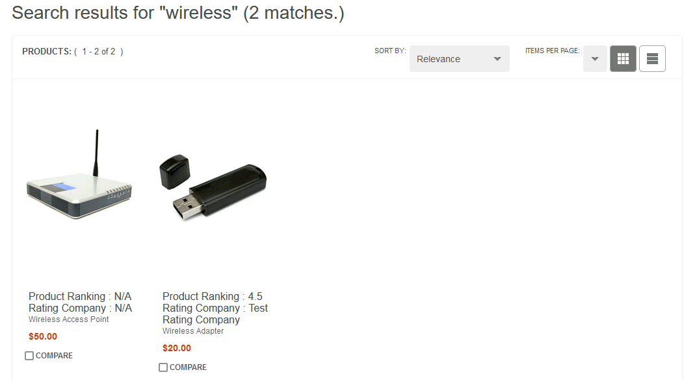
Important areas of the Project with screenshots
Displaying the Custom Data

Slide 9
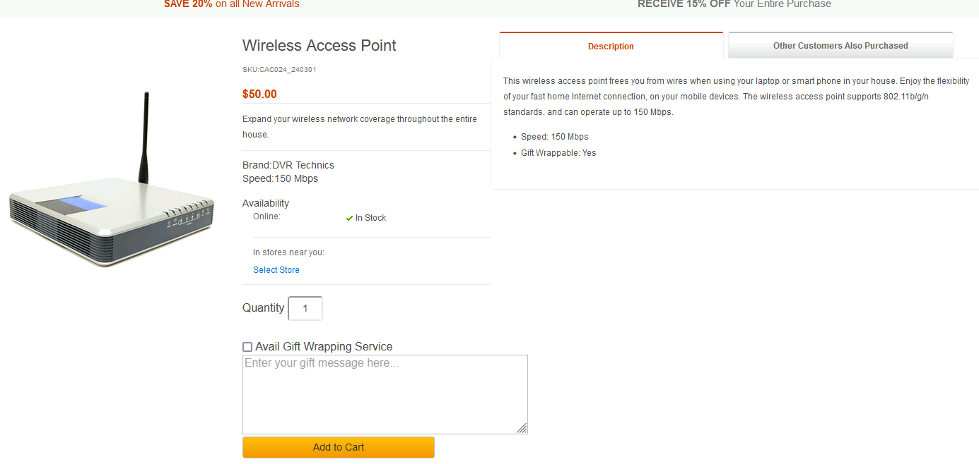
Important areas of the Project with screenshots
Gift Wrapping Service

Slide 10
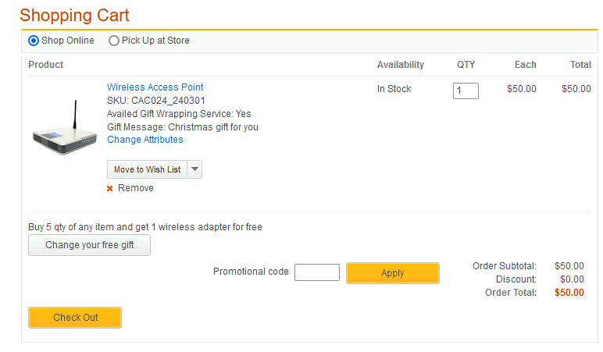
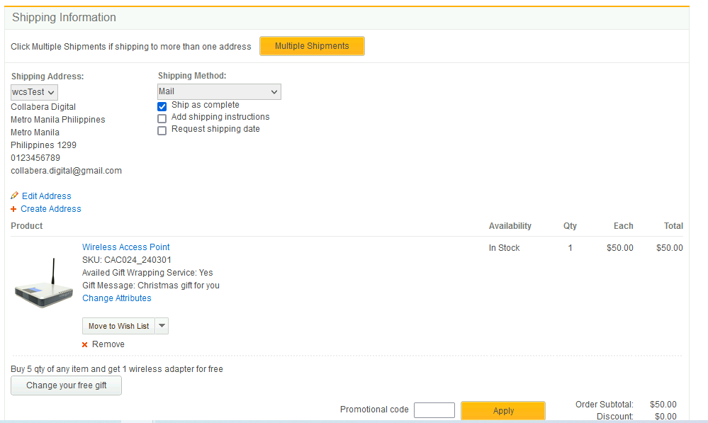
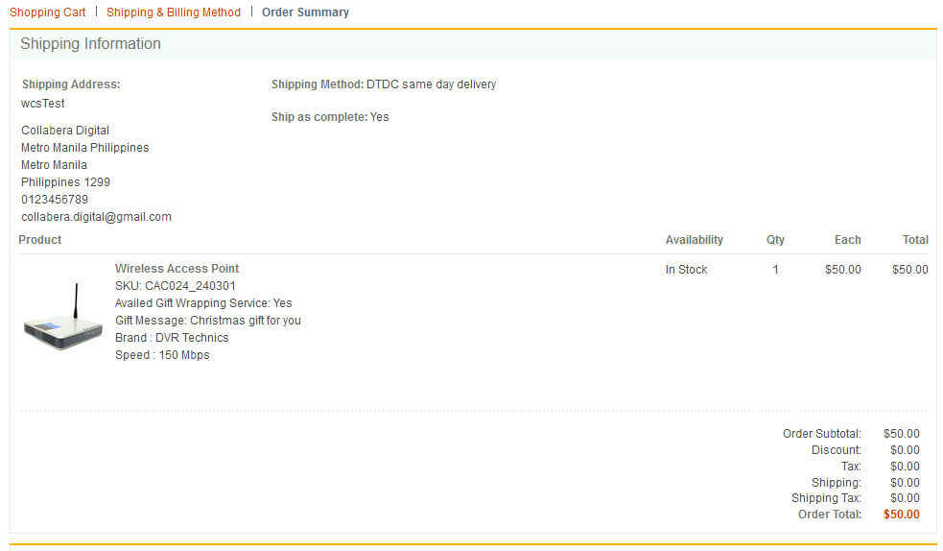
Important areas of the Project with screenshots
Display Gift Wrapping Service
User’s Cart
Checkout Section
Order Confirmation

Slide 11
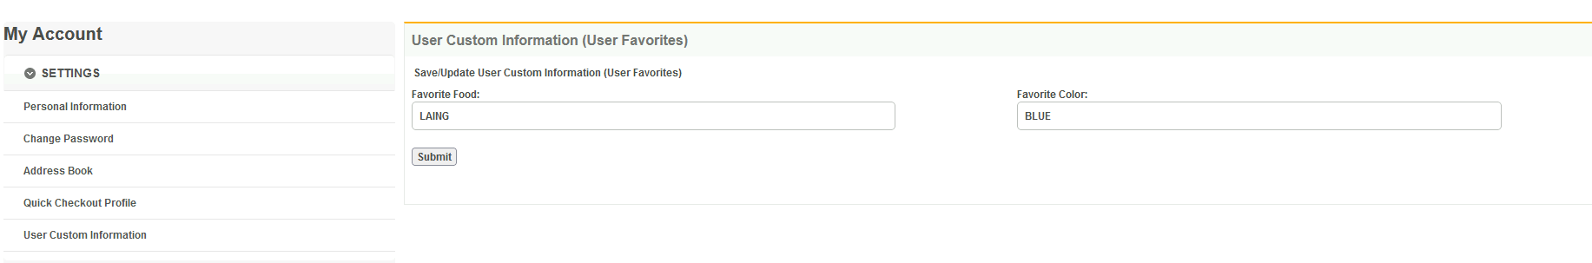
Important areas of the Project with screenshots
Adding custom user information

Slide 12
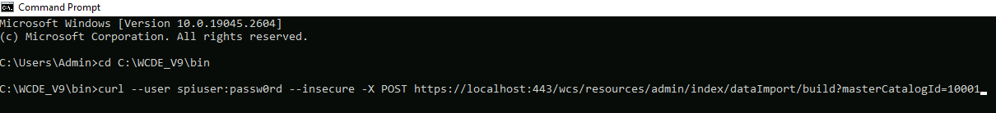
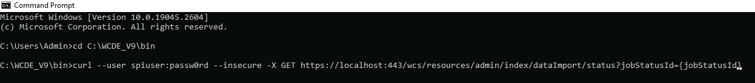
Important areas of the Project with screenshots
Building Index
POST Command
GET job status

Slide 13
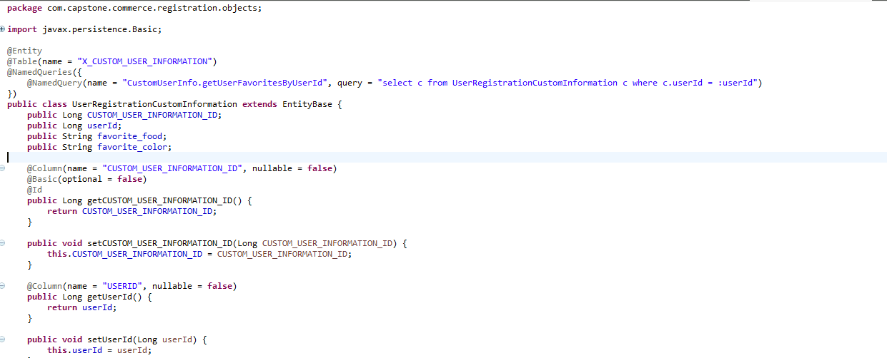
Important areas of the Project with screenshots
Creating JPA

Slide 14
Conclusion
Training Conclusion
The training overall helped me familiarized not only the language used but also on how things works on an E-Commerce website. As a developer without any experience in developing an E-Commerce website, this training serves as an eye opener on concepts and principles of E-Commerce. I learned here that HCL Commerce is a well established software or tool that is used to create an E-Commerce website. Will all the pre defined features available on the software, it will be easy for the developer to modify an existing website depending on the requirements of business. Aside from this, it also includes some utilities to be used by the stakeholders if ever they want to put some changes on how the website will behave.
I also learned that if ever you need to add or modify a large number of data in the DB, you can use the dataload strategy that can be executed by command prompt. It is much safer than executing a query in DB2. During the training, we also tackled about the indexing the external data in HCL Commerce search on which you can modify what will be the result of what the user is searching. There are also reserved fields on some tables in the database that can be used if there will be a need of customization of the data in the website.
Overall for me, the training went well and the trainers did their part on teaching us all about HCL Commerce. I am looking forward for another training which will tackle the in depth part of the software.

Slide 15
Thank You
www.collaberadigital.com

Slide 16
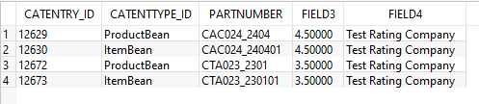
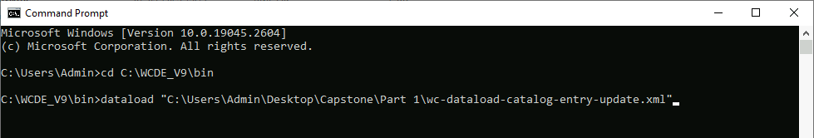
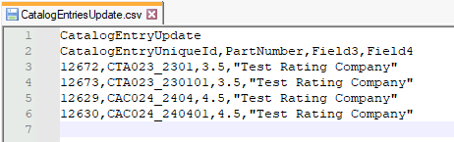
Problem Statement of the Capstone Project PART 1
Step 1
You must see the changes in CATENTRY table in WCS DB.
Open cmd then navigate to the WCE_INSTALL_DIR\bin
Enter the command line : dataload “WC-dataload-xml-directory\wc-dataload-catalog-entry-update.xml"
3.
1.
Make a csv to be loaded by the dataload command
2.

Slide 17

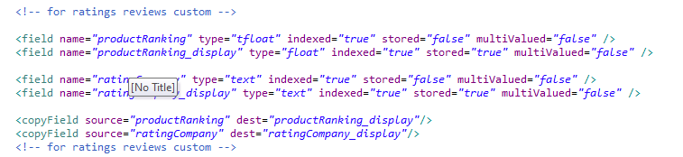
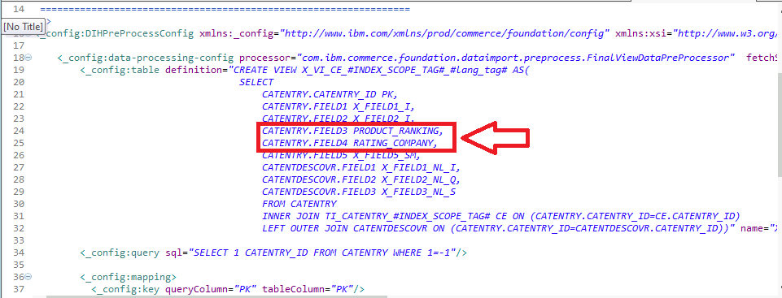
Problem Statement of the Capstone Project PART 1
Step 2
Firstly, extend the catalog entry search index schema. Go to x-schema.xml file in workspace_dirsearch-config-ext\src\index\managed-solr\config\v3\CatalogEntry and add these codes.
Open the file x-data-config.xml in search-config-ext\src\index\managed-solr\config\v3\CatalogEntry and add the following codes.
1.
3.
After that, you need to build the search index by executing the command line in the cmd prompt which is pointing to the WC_INSTALL_DIR\bin and restart your transaction server.
4.
Navigate to the file name wc-dataimport-preprocess-x-finalbuild.xml. You can find the file inside workspace_dir\WC\xml\search\dataImport\v3\dbtype2\CatalogEntry then change the alias for CATENTRY.FIELD3 & CATENTRY.FIELD4 to your desired alias.
5.
2.
Cont.

Slide 18
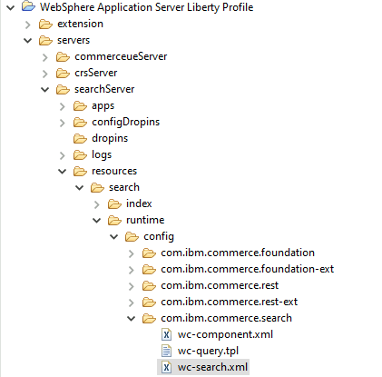
Problem Statement of the Capstone Project PART 1
Step 2 Cont.
Add files wc-component.xml & wc-search.xml in /WebSphere Application Server Liberty Profile/servers/searchServer/resources/search/runtime/config/com.ibm.commerce.search/
Go to your e-comm website and try to search the catalog entries you modified to add the ranking and you must see the changes like in the image below:
7.
6.
Fore more information regarding Indexing external data in HCL Commerce https://help.hcltechsw.com/commerce/9.0.0/tutorials/tutorial/tsd_search2_intro.html

Slide 19





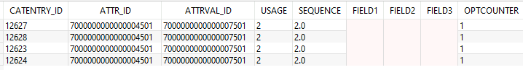
Problem Statement of the Capstone Project PART 1
Step 3
First, you must use dataload to add data into the specified table (ATTR,ATTRDESC,ATTRVAL,ATTRVALDESC,CATENTRYATTR). Execute the command line in cmd dataload “C:\Users\Admin\Desktop\Capstone\Part 3\Attribute Dataload Files\wc-dataload.xml”.
1.
After dataloading, you must see the added data to the WCS DB on the specified tables (ATTR,ATTRDESC,ATTRVAL,ATTRVALDESC,CATENTRYATTR).
2.
ATTR
ATTRDESC
ATTRVAL
ATTRVALDESC
CATENTRYATTR

Slide 20
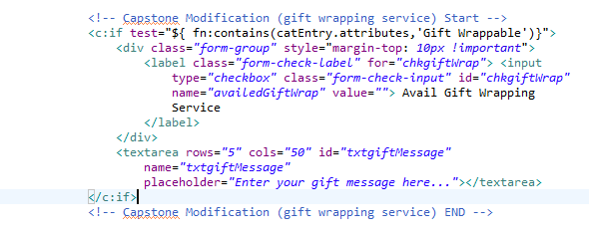

Problem Statement of the Capstone Project PART 1
Step 5
To allow the customer to avail the gift wrapping service, we need to modify the Product Display Page of the product with Gift Wrap able attribute. Add the following code to ShopperActions_UI.jspf
After adding the code you must be able to see the checkbox together with the textarea in the PDP.
2.
1.
Newly added product attribute.
After putting message and adding the product to cart you must see the message in your ORDITEMEXTATTR table.
Checkbox & textarea for gift wrapping service
3.

Slide 21
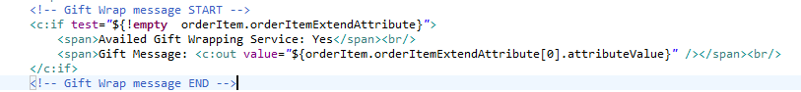
Problem Statement of the Capstone Project PART 1
Step 6
To display the message and if the user availed the gift wrapping service in the cart page, you must modify/extend the JSP file OrderItemDetails.jsp located at crs-web/WebContent/AuroraStorefrontAssetStore/Snippets/Order/Cart then add the code below on your desired destination.
After that you must be able to see the custom data in the Cart Page of the user. Refer to the image below.
1.
Cont.

Slide 22
Problem Statement of the Capstone Project PART 1
To display the message and if the user availed the gift wrapping service in the check out section, you must modify/extend the JSP file OrderItemDetails.jsp located at crs-web/WebContent/AuroraStorefrontAssetStore/ShoppingArea/CheckoutSection/SingleShipment/ then add the code below on your desired destination.
After that you must be able to see the custom data in the Checkout Section of the user. Refer to the image below.
1.
Cont.

Slide 23
Problem Statement of the Capstone Project PART 1
Step 6 Cont.
To display the message and if the user availed the gift wrapping service in the check out section, you must modify/extend the JSP file OrderItemDetailSummary.jsp located at crs-web/WebContent/AuroraStorefrontAssetStore/ShoppingArea/CheckoutSection/SingleShipment/ then add the code below on your desired destination.
After that you must be able to see the custom data in the Order Confirmation Page of the user. Refer to the image below.
1.

Slide 24
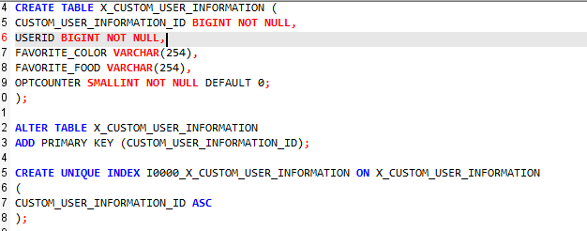
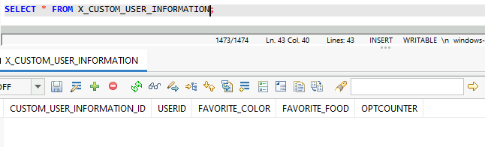
Problem Statement of the Capstone Project PART 2
Step 1
Execute the SQL Query below to create and configure your new custom table.
To check if the creation succeed, execute a select query on the table specified.
1.

Slide 25
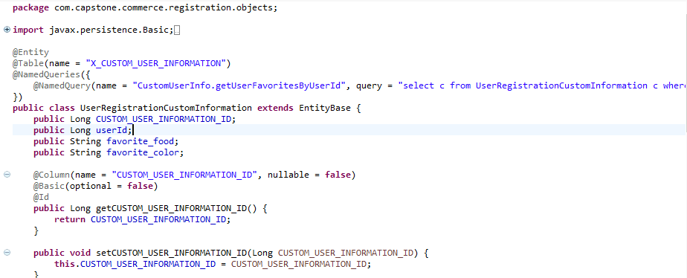
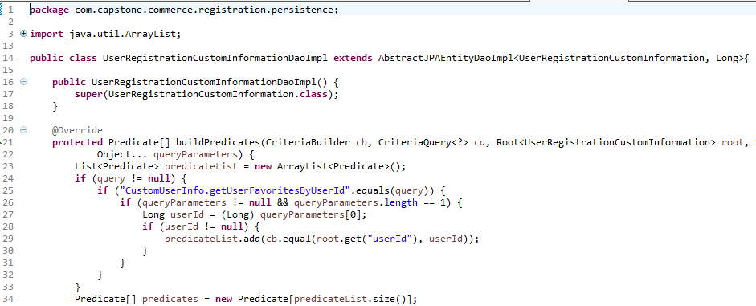
Problem Statement of the Capstone Project PART 2
Step 2
Next, you need to create a JPA for you to be able to save and edit the data using the controller command.
Create first the entity which should look like the image below:
You also need to create a Data Access Object Implementation that extends AbstractJPAEntityDaoImpl which looks like the image below:
1.
It is just like the copy of your table in the DB and you must annotate all the columns correctly so that it will map all of it accurately.

Slide 26
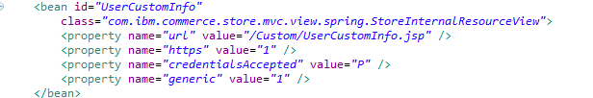
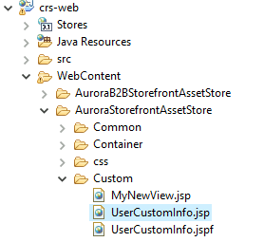
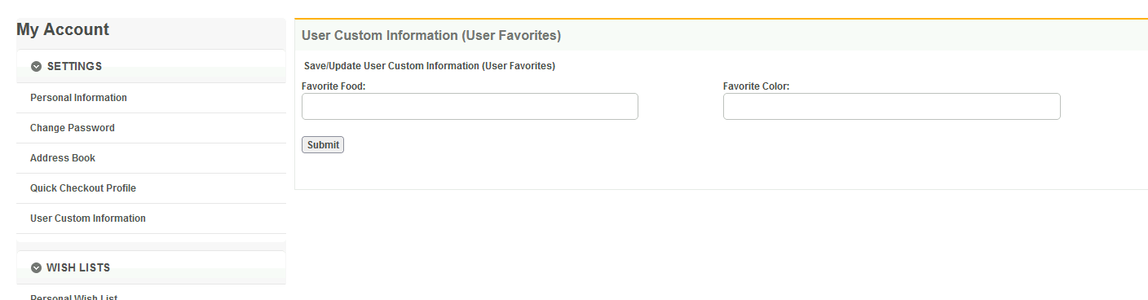
Problem Statement of the Capstone Project PART 2
Step 3
Next create a JSP that will contain the form that will be used to save and edit the custom information of the user which is the Favorite Color and Favorite Food.
You can add new folder on the directory WC_INSTALLATION_DIR\workspace\crs-web\WebContent\AuroraStorefrontAssetStore\ and inside that folder you can create your new JSP.
Don’t forget to register your new JSP in view-ext.xml located in crs-web\WebContent\AuroraStorefrontAssetStore\
To register the JSP, add the following codes in the said xml file.
2.
1.
After registering and adding the form in the JSP, you must be able to visit your custom JSP.
3.

Slide 27
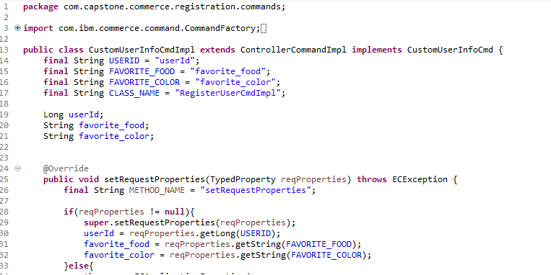
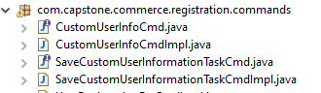
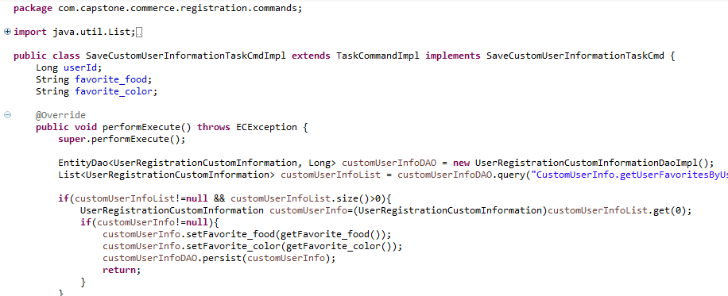
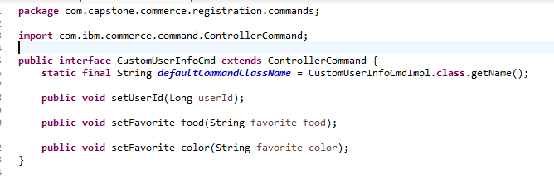
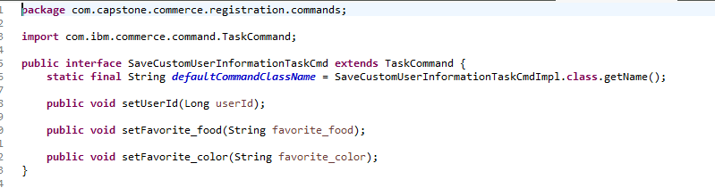
Problem Statement of the Capstone Project PART 2
Step 4
Controller Command Implementation (Class)
In order to have a function that will save, get and edit the custom information of the user, you will need to create a controller command, task command and its implementations.
1.
Task Command Implementation (Class)
Below are the snippets of the codes inside these files.
2.
Controller Command (Interface)
Task Command (Interface)
When the controller command was called by the Rest handler it will process all the code inside of it and will also call the task command in which the process of saving, getting and editing the data happens.

Slide 28
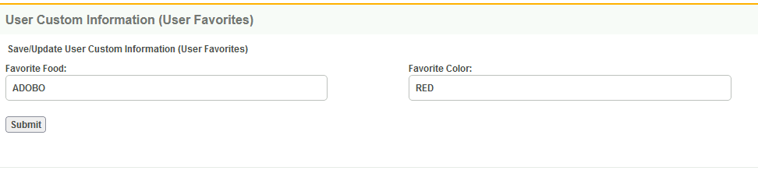
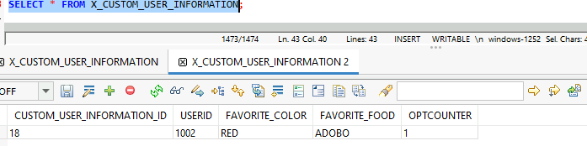
Problem Statement of the Capstone Project PART 2
Step 5
After that visit the page and put values on the textbox and hit the submit button, you must be able to save the custom information.
Also check the custom table you created earlier to be confident that the custom information was saved accurately
2.
1.

